Slide 1
Manan Malhotra-POC
THE REASONS EMPLOYEE ARE PRONE TO LEAVE

Slide 2


Value count for salaries for existing and ex-employees
Current Employee Data
As we can see that the people who left have less number of high salaries which means that they were not paid good salaries
Ex Employee Data

Slide 3
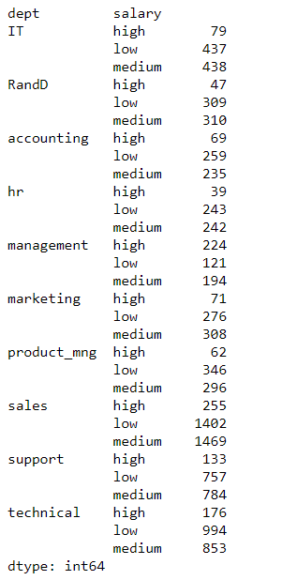
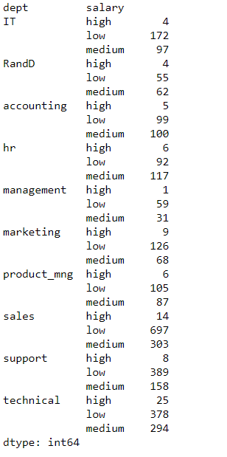
Department wise salary data to support low salary theory for Ex-employees
Ex Employee Data
Current Employee Data

Slide 4
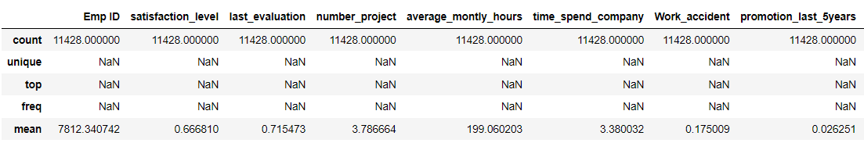
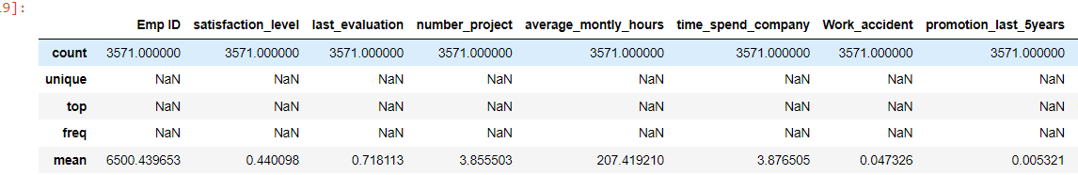
Mean of the satisfaction level of Ex-employees is much lower which shows they were less happy
Current Employee Data
Ex Employee Data

Slide 5
Mean of the number of projects of Ex-employees is little higher which shows they completed equal or more projects and were still paid less
Current Employee Data
Ex Employee Data

Slide 6
Mean of the number of average monthly hours of Ex-employees is little higher which shows they spend more time and efforts and were still paid less
Current Employee Data
Ex Employee Data

Slide 7
Mean of the number of work accidents of Ex-employees is lesser than the current employees this shows they made less mistakes so were not paid according to their potential
Current Employee Data
Ex Employee Data

Slide 8
Mean of the number of promotions of Ex-employees is very less than the current employees this shows they were not being promoted so were facing troubles with promotions
Current Employee Data
Ex Employee Data

Slide 9
Conclusion from results
As we can see from the data that the most common factor for ex-employees is the lower salaries and no recognition for their hard work which caused troubles with their promotions and they decided to leave the company even after spending more hours and completing more projects.

Slide 10
Final Conclusion
To stop employees from leaving in future a correct amount of salary package and timely promotions should be given to the recognized and hardworking employees so that they are motivated more and they feel appreciated.
Also, their satisfaction level should be monitored on timely basis to keep their growth with the company in check.

